Slide 1

CSE 229:Engineering ethics and cyber law
Presented by:
Dr. Mst. Jannatul Ferdous
Professor
Department of Computer Science and Engineering
Jatiya Kabi Kazi Nazrul Islam University, Bangladesh
Email: mjferdous_cse@jkkniu.edu.bd, mjannatul@gmail.com
24th September, 2024

Slide 2
Service-learning
Service Learning is an educational approach where a student learns theories in the classroom and at the same time volunteers with an agency (usually a non-profit or social service group) and engages in reflection activities to deepen their understanding of what is being taught.
It is a cycle of theories, practices, and reflection tools to broaden knowledge and critical thinking skills for social change.
https://www.elmhurst.edu/blog/what-is-service-learning/

Slide 3
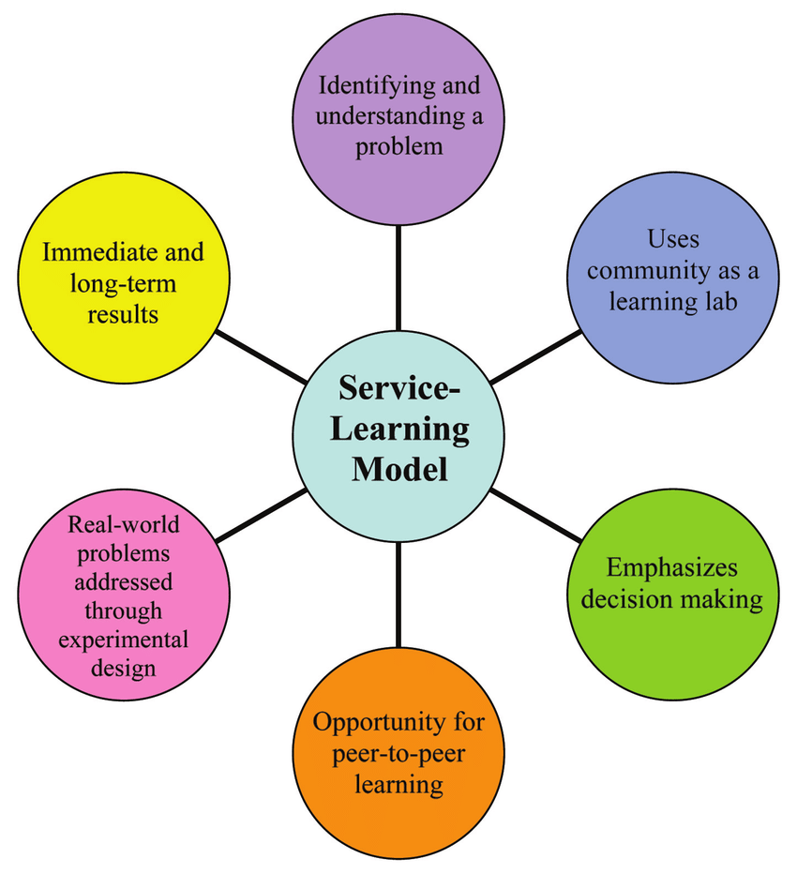
Benefits of a service-learning Integrated Planning Model (IPM) model
Service-learning is an experiential learning pedagogy that moves students beyond the classroom to become active participants in their learning and develop civic knowledge and skills. Students who take service-learning courses work with local, national, and international non-profit and public organizations to deeply learn and practice course content by working on a real, community-identified need. Students learn the course material, get to work directly on an issue facing the community, and learn about their communities in the process.

Slide 4
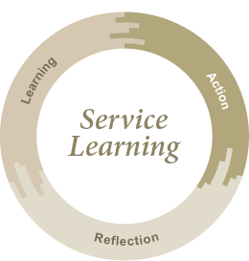
What is service learning in ethics?
Service learning is a form of experiential learning where students apply academic knowledge and critical thinking skills to address genuine community needs.
What are the stages of service learning?
The service-learning process takes students through the stages of Investigation, Preparation, Action, Reflection, Demonstration, and Evaluation.
Elements of service learning
Service learning consists of three equally important elements:
Action (practical, community service-oriented, accountable to oneself and others)
Learning (professional, methodological, individual, and social)
Reflection (professional, methodological, personal, and social)

Slide 5
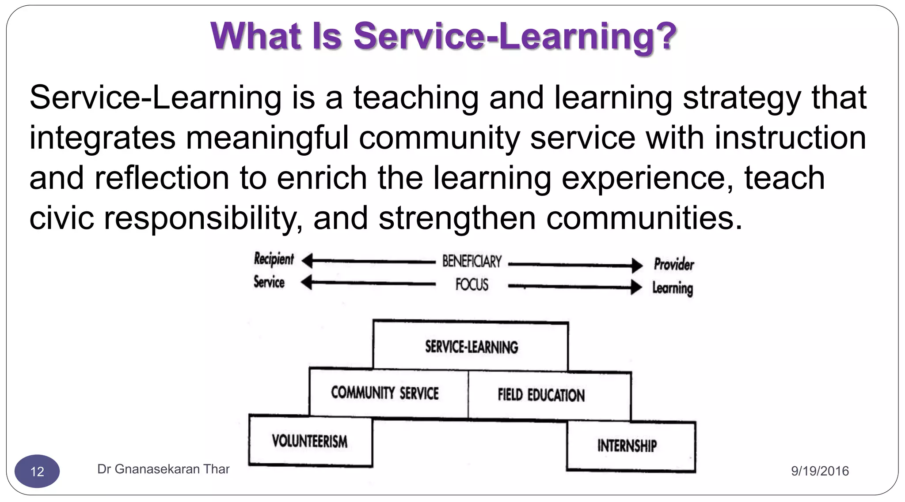

Slide 6
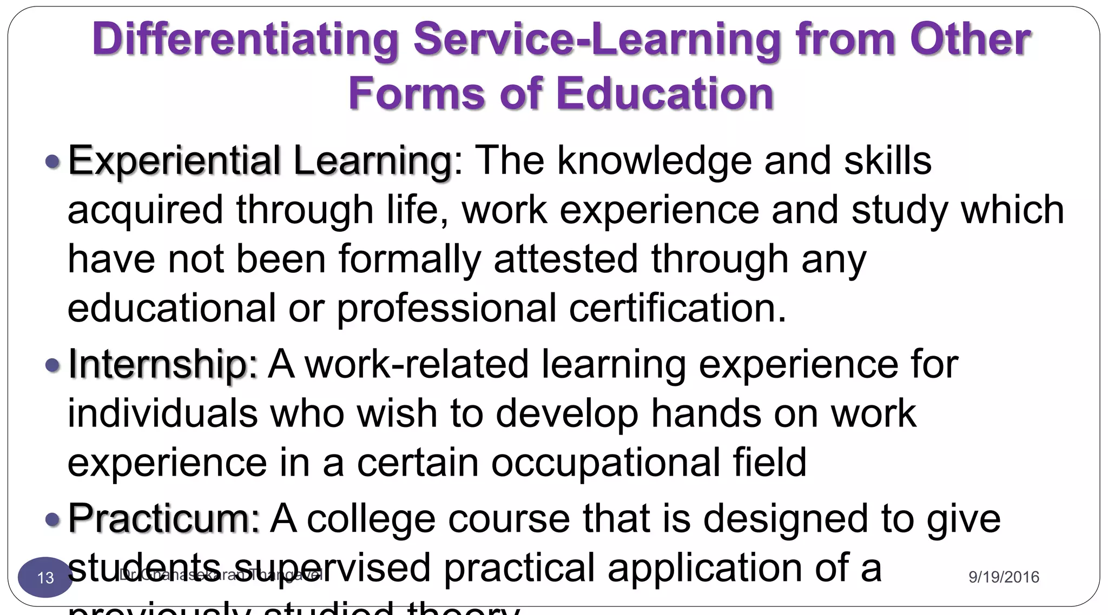

Slide 7
Computer and Information Ethics
What is computer and information ethics?
Computer ethics is a field of applied ethics that addresses ethical issues in the use, design, and management of information technology and in the formulation of ethical policies for its regulation in society.
What are the 4 ethics involved in using a computer?
Do not in any way examine or change files or passwords belonging to others.
Do not violate the privacy of individuals or organizations.
Respect the integrity of the computing systems.
Do not develop or use programs that invade, damage, or alter computing systems or software.
Who is the father of computer ethics?
The concept of computer ethics originated in the 1940s with MIT professor Norbert Wiener, the American mathematician and philosopher.
https://online.glyndwr.ac.uk/what-is-computer-ethics/

Slide 8
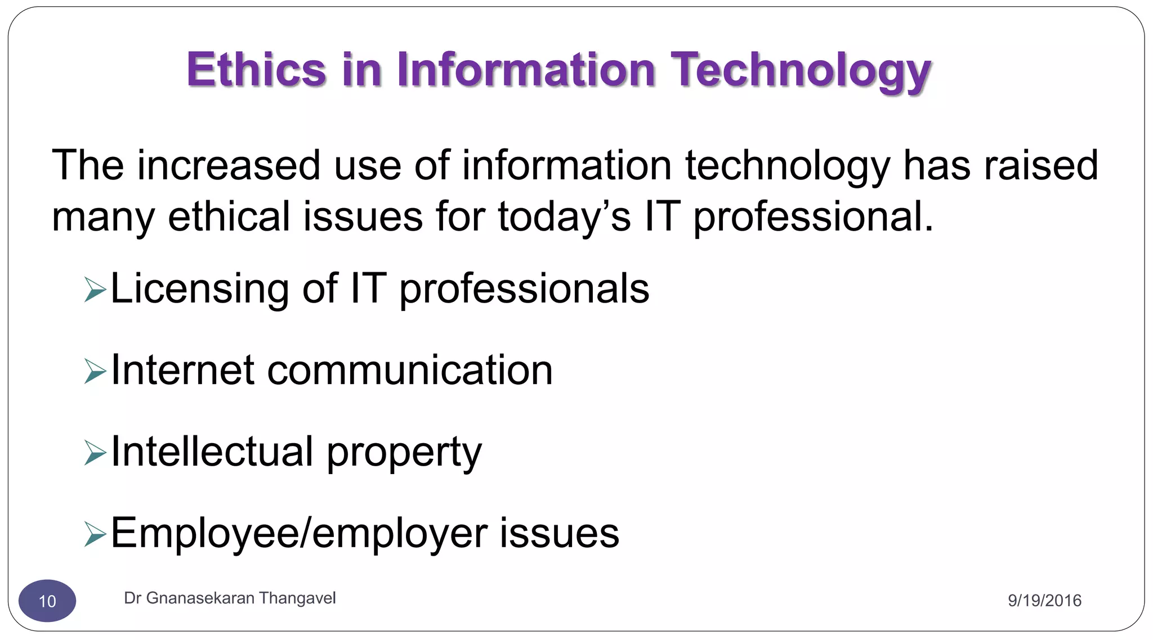
https://plato.stanford.edu/Archives/Fall2012/entries/ethics-computer/
What is information ethics?
Information ethics is concerned with ethical, legal and societal aspects of using information and communication technologies.
https://en.wikibooks.org/wiki/Introduction_to_Computer_Information_Systems/Ethics

Slide 9
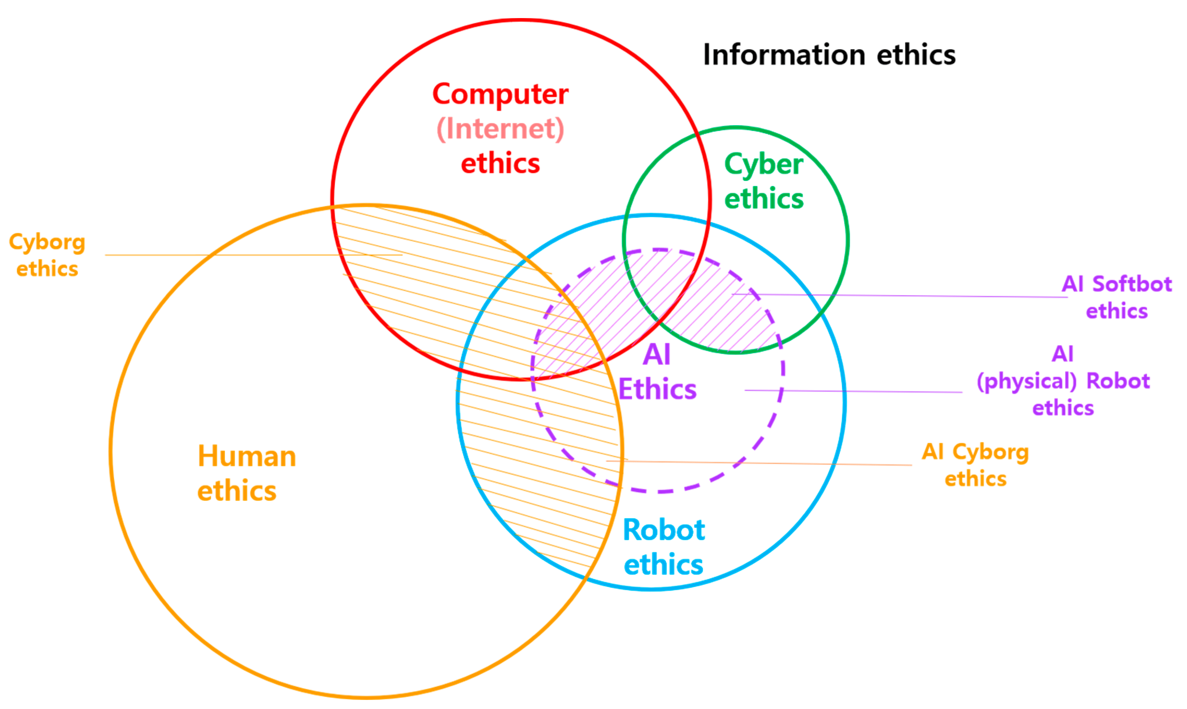

Slide 10
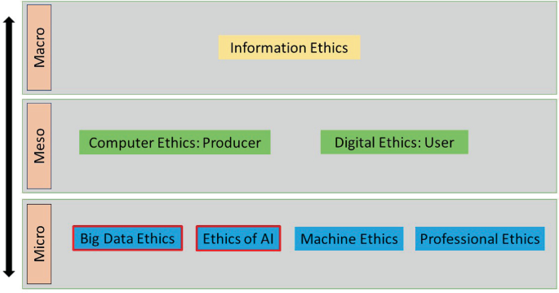

Slide 11
Developing ethical analysis skills and professional values
https://www.careeraddict.com/ethics-professional-growth-career-development
The Importance of Ethics in Professional Development
They build up your reputation
They provide emotional security
They promote teamwork
They enhance your commitment and performance
They attract talent
They establish a code of conduct
They can make you a role model
They lead to business growth
They widen your network
They lead to highly valued work

Slide 12
What are professional values and professional ethics?
The major component of professional values is dedication toward work, self-motivation, motivation for others, responsibility, honesty, discipline, positive attitude toward every type of situation, etc.
Similarly, the main component of professional ethics is accountability, transparency, adherence to law, etc.
* Adherence attachment or commitment to a person, cause, or belief.

Slide 13
Introduction to Yoga and meditation for professional excellence and stress management
What is professional excellence?
Professional excellence means being recognized for your skills as a communicator and serving as a role model to others. Professional excellence is normally associated with knowledge and skill.
How do yoga and meditation help in professional excellence and stress management?
Yoga and Meditation together help an individual to This practice optimizes the body's sympathetic responses to stressful stimuli and restores autonomic regulatory reflex mechanisms associated with stress.
What is the role of yoga in professional excellence?
Yoga provides effective stress management techniques through deep breathing, relaxation, and mindfulness. Regular practice of yoga can help professionals reduce stress levels, enhance focus, and maintain a calm and composed demeanor even during challenging situations.
https://www.londonspring.org/yoga-and-meditation-for-professional-excellence-and-stress-management/

Slide 14
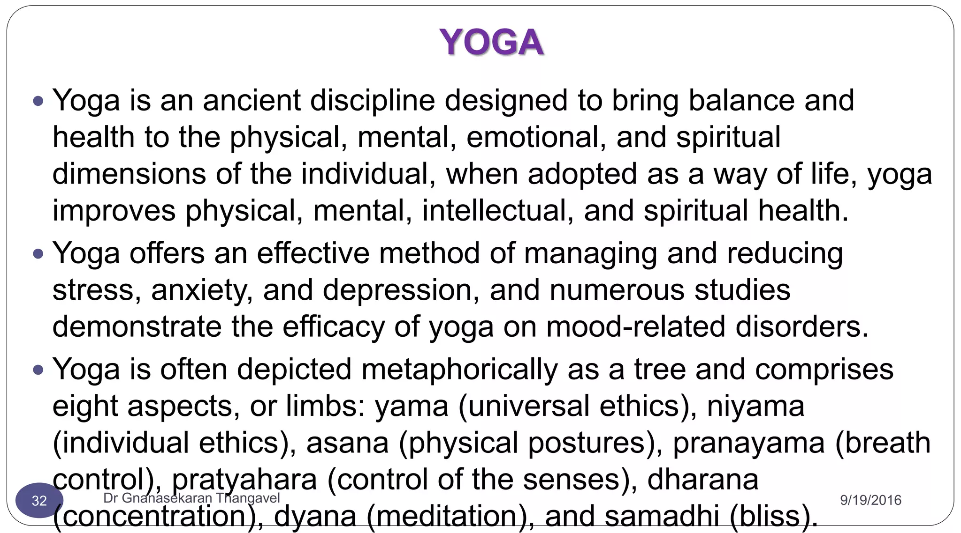

Slide 15
What is Cyber Law?
Cyber law, also known as Internet Law. It is part of the overall legal system that is related to legal informatics and supervises the digital circulation of information, e-commerce, software, and information security. It is associated with legal informatics and electronic elements, including information systems, computers, software, and hardware. It covers many areas, such as access to and usage of the Internet, encompassing various subtopics as well as freedom of expression, and online privacy.
Cyber law deals with the legal aspects of cyberspace, the internet, and computing. In a broader view, cyber law handles the issues of intellectual property, contracts, jurisdiction, data protection laws, privacy, and freedom of expression in the digital space.
Cyber law is any law that applies to the internet and internet-related technologies. Cyber law is one of the newest areas of the legal system. This is because internet technology develops at such a rapid pace. Cyberlaw provides legal protections to people using the internet. This includes both businesses and everyday citizens. Understanding cyber law is of the utmost importance to anyone who uses the internet. Cyber Law has also been referred to as the "law of the internet."

Slide 16
Cyberspace
Cyberspace is that space in which users share information, interact with each other; engage in discussions or social media platforms, and many other activities.
What is an example of a cyberspace?
Social networking sites such as Facebook, Twitter, and Instagram are examples of cyberspace where people can connect and communicate with each other, regardless of their physical location.
What are the features of cyberspace?
Since cyberspace is a virtual space, it has no boundaries, mass, or gravity. It simply represents the interconnected space between computers, systems, and other networks. It exists in the form of bits and bytes – zeroes and ones (0's and 1's).

Slide 17
What is cyberspace and its components?
“Cyberspace is a global domain within the information environment consisting of the interdependent network of information systems infrastructures including the Internet, telecommunications networks, computer systems, and embedded processors and controllers.” ( National Institute of Standards and Technology)

Slide 18
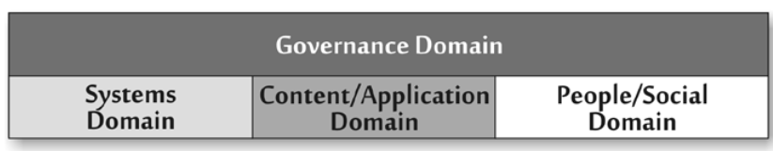
Domains of Cyberspace
The systems domain comprises the technical foundation, infrastructure, and architecture of cyberspace. It includes hardware and software, as well as the infrastructure items supporting them, such as the electrical power grid.
The content and application domain contain both the information base that resides in cyberspace and the mechanisms for accessing and processing this information.
Communication among people and interactions between people and information occurs
in the people and social domain. Businesses, consumers, advocacy groups, political campaigns, and social movements are in this domain.
The governance domain overlays all of the aspects of cyberspace, including the technological specifications for the systems domain, the conventions for data formatting and exchange in the content and application domain, and the legal frameworks of various countries associated with the people and social domain.
https://ictd.portal.gov.bd/sites/default/files/files/ictd.portal.gov.bd/publications/effc311d_5097_46ba_afa4_5f44b60a93e6/Bangladesh%20Cyber%20Threat%20Landscape%202022.pdf

Slide 19
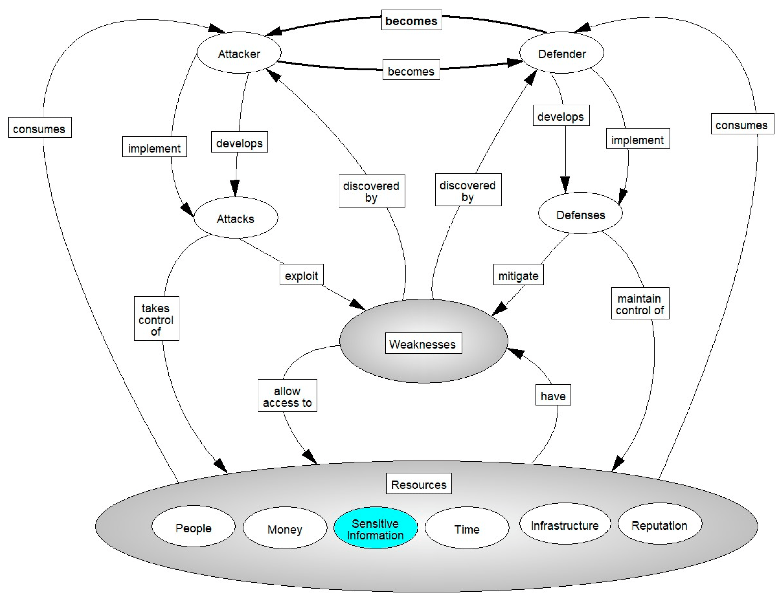
Cyber warfare Systemigram: Complete.

Slide 20
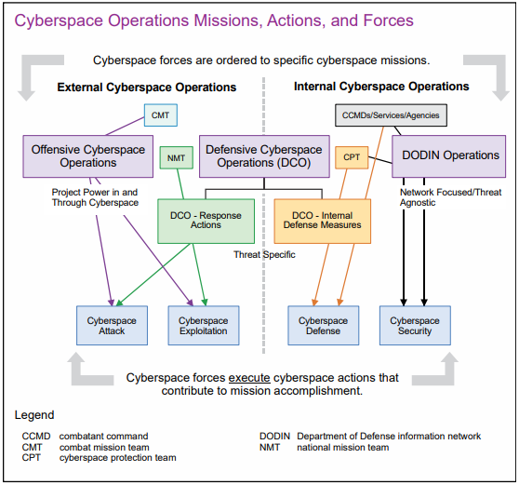

Slide 21
Computer Ethical Issues
Some of the common ethical issues are listed below:
• Cyber crime
• Software Piracy
• Unauthorized Access
• Hacking
• Use of computers to commit fraud
• Sabotage in the form of viruses
• Making false claims using computer cybercrime
*Sabotage-deliberately destroy, damage, or obstruct (something), especially for political or military advantage.

Slide 22
Cybercrime and Cybersecurity
Areas that are related to cyber law include cybercrime and cybersecurity. With the right cybersecurity, businesses and people can protect themselves from cybercrime. Cybersecurity looks to address weaknesses in computers and networks. The International Cybersecurity Standard is known as ISO 27001.
Cybersecurity policy is focused on providing guidance to anyone who might be vulnerable to cybercrime. This includes businesses, individuals, and even the government. Many countries are looking for ways to promote cybersecurity and prevent cybercrime.
https://www.brainkart.com/article/Computer-Ethical-Issues_36702/

Slide 23
What are the various crimes happening using computers?
✅ 1. Hacking: Unauthorized access to computer systems, networks, or data.
✅ 2. Phishing: Fake emails or websites used to trick users into providing sensitive information (like passwords, bank details).
✅ 3. Identity Theft: Stealing someone’s personal information to commit fraud or impersonate them online.
✅ 4. Cyber Stalking: Using digital means (emails, social media, messages) to stalk, threaten, or harass individuals.
✅ 5. Malware Attacks: Spreading malicious software to damage or control computers without user consent.
✅ 6. Cyber Terrorism: Using cyberspace to cause disruption, fear, or harm to national security, infrastructure, or people.
✅ 7. Financial Scams: Credit card fraud, online shopping scams, investment frauds using fake websites or apps.
✅ 8. Cyberbullying: Bullying or abusing someone online through messages, social media, or gaming platforms.
✅ 9. Cyber Pornography: Creating, publishing, or distributing obscene content via the internet.
✅ 10. Software Piracy: Unauthorized copying, distribution, or use of licensed software or digital media.

Slide 24
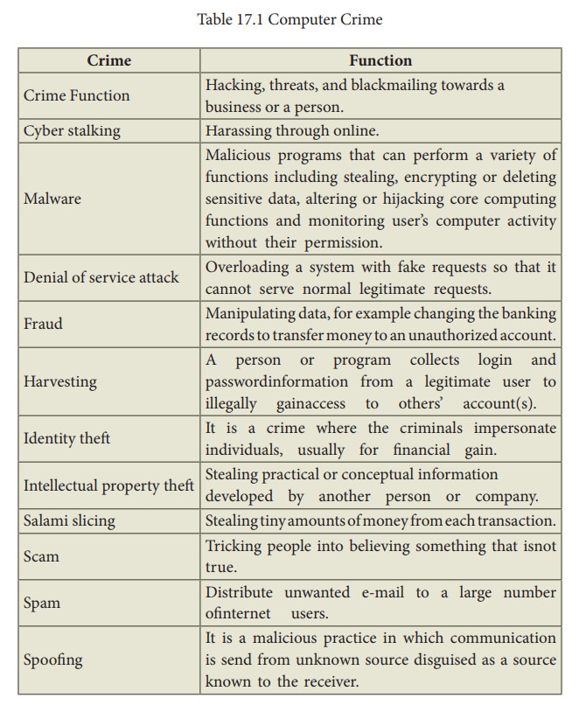
Typosquatting, also known as URL hijacking, is a form of cybersquatting (sitting on sites under someone else's brand or copyright) that targets Internet users who incorrectly type a website address into their web browser (e.g., “Gooogle.com” instead of “Google.com”).

Slide 25
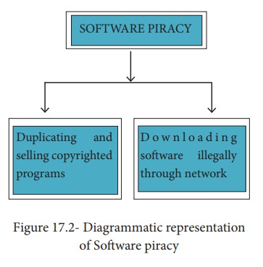
SOFTWARE PIRACY
Software Piracy is about the copyright violation of software created originally by an individual or an institution. It includes stealing of codes/programs and other information illegally creating duplicate copies by unauthorized means and utilizing this data either for one’s own benefit or for commercial profit.
In simple words, Software Piracy is “unauthorized copying of software”. Figure 17.2 shows a diagrammatical representation of software piracy.

Slide 26
UNAUTHORIZED ACCESS
Unauthorized access is when someone gains access to a website, program, server, service, or other system by breaking into a legitimate user account. For example, if someone tries guessing a password or username for an account that was not theirs until they gained access, it is considered unauthorized access.
To prevent unauthorized access, Firewalls, Intrusion Detection Systems (IDS), Virus and Content Scanners, Patches and Hot fixes are used.
Intellectual property infringement is the violation of an intellectual property right. For example, creating a listing using a third party's image, trademark, logo, design, etc., without the appropriate permission from the intellectual property rights owner, can constitute intellectual property infringement.

Slide 27
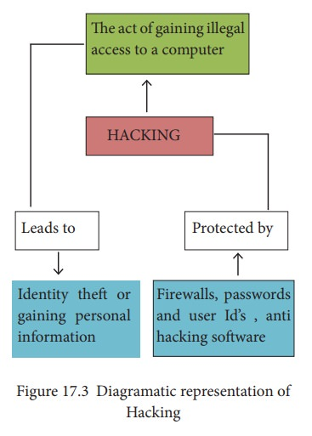
HACKING
Hacking is intruding into a computer system to steal personal data without the owner’s permission or knowledge (like to steal a password). It is also gaining unauthorized access to a computer system, and altering its contents. It may be done in pursuit of a criminal activity or it may be a hobby. Hacking may be harmless if the hacker is only enjoying the challenge of breaking systems’ defenses, but such ethical hacking should be practiced only as controlled experiments. Figure 17.3 shows a diagrammatic representation of Hacking.

Slide 28
CRACKING
start doing something quickly
Cracking is where someone edits a program source so that the code can be exploited or modified. A cracker (also called a black hat or dark side hacker) is a malicious or criminal hacker. “Cracking” means trying to get into computer systems in order to steal, corrupt, or illegitimately view data.
A cracker is someone who breaks into someone else's computer system, often on a network, bypassing passwords or licenses in computer programs.
Software cracking is the most often used type of cracking which is nothing but removing the encoded copy protection. There is another type of cracking called password cracking. This is mainly used to crack the passwords. Password cracking can be performed either by using an automated program or can be manually realized.
One more interesting fact about cracking is social engineering. It is a method of getting passwords and information using human weakness. These crackers trick people, not software. They can use just the phone to get information, they can pretend to be your friend and talk to you on Internet Relay Chat(IRC) or by Instant Messenger. e-mail can also be a source for them. They may send official e-mails requesting some sensitive information. It may look like a legitimate e-mail from a bank or other official institution.

Slide 29
Categories of Cyber Crime
Generally, there are three major categories of cybercrimes that you need to know about. These categories include:
Crimes Against People: While these crimes occur online, they affect the lives of actual people. Some of these crimes include cyber harassment and stalking, distribution of child pornography, various types of spoofing, credit card fraud, human trafficking, identity theft, and online-related libel or slander.
Crimes Against Property: Some online crimes happen against property, such as a computer or server. These crimes include DDOS attacks, hacking, virus transmission, cyber and typosquatting, computer vandalism, copyright infringement, and IPR violations.
Crimes Against Government: When a cybercrime is committed against the government, it is considered an attack on that nation's sovereignty and an act of war. Cybercrimes against the government include hacking, accessing confidential information, cyber warfare, cyber terrorism, and pirated software.

Slide 30
Internet abuse
Internet abuse refers to improper use of the Internet and may include:
Cyberbullying, the use of the internet to bully and intimidate.
Cybercrime, use of computers in criminal activity
Cybersex trafficking, the live streaming of coerced sexual acts and or rape
Internet homicide, the killing online - the killing of one person by another.
Malware, software designed to harm a user's computer, including computer viruses
Spamming, sending unwanted advertising

Slide 31
The Internet’s positive effects include the following:
The Internet provides effective communication using emailing and instant messaging services, no matter where you are.
It saves time, which improves business relationships and transactions.
Shopping and banking online have made everyday life less complex.
You can get global news without relying on television or newspapers.
The availability of millions of books and journals online has provided a huge boost to education. Students can now take online courses using the internet. Research has become easier as a result.
Modern job applications have become simpler, as most jobs are posted online and applications are now the norm.
Professionals can now enhance their research by exchanging information and materials online.

Slide 32
The Negative Impacts of the Internet on Society include:
Availability of illegal or inappropriate materials online that isn’t age-suitable is easy to access
Long periods of screen time can negatively affect our health and communication skills by causing insomnia, eye strain, and anxiety and depression.
A person’s personal and professional life can be disrupted by an addiction to social networking.
Some criminals use the Internet to hack into people’s accounts for nefarious (criminal) purposes, such as stealing data or financial information.

Slide 33
Internet and their Impacts in Society;
What are the positive and negative impacts of the Internet on society?
It has also had positive impacts on social interactions and media. However, there are also negative effects such as addiction, cyberbullying, and decreased face-to-face communication skills. The internet can also negatively affect academic performance if not used properly.
What are the bad impacts of the internet on society?
Studies show that information overload affects up to 20-30% of people. Damage to social relationships: Extensive internet use, of social media in particular, is correlated with loneliness and social isolation. Internet use can degrade intimate relationships, particularly due to viewing online pornography.

Slide 34
What is the impact of computers and the Internet on society?
It has made it easier and faster to connect with people around the world and to access a vast amount of information on almost any topic. It has also opened up new opportunities for businesses and entrepreneurs to reach customers and markets they would never have had access to before.

Slide 35
What is Intellectual Property?
Intellectual property (IP) refers to creations of the mind, such as inventions; literary and artistic works; designs; and symbols, names and images used in commerce.
IP is protected in law by, for example, patents, copyright and trademarks, which enable people to earn recognition or financial benefit from what they invent or create. By striking the right balance between the interests of innovators and the wider public interest, the IP system aims to foster an environment in which creativity and innovation can flourish.
https://www.wipo.int/about-ip/en/

